Slide 1
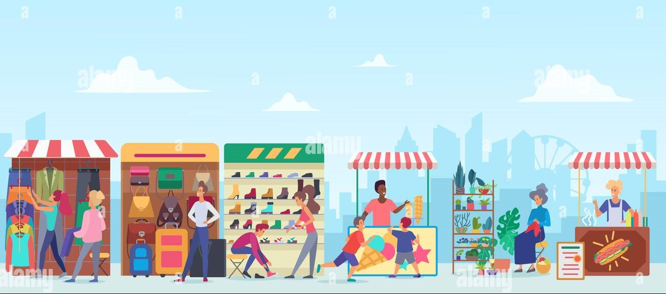
Platform Development for Hawkers
Project By:
Mohammed Taha Al-Daghan
Kazim Ayaan P S
Syeda Hafzaa Shifa
Md Faisal Ahmed

Slide 2

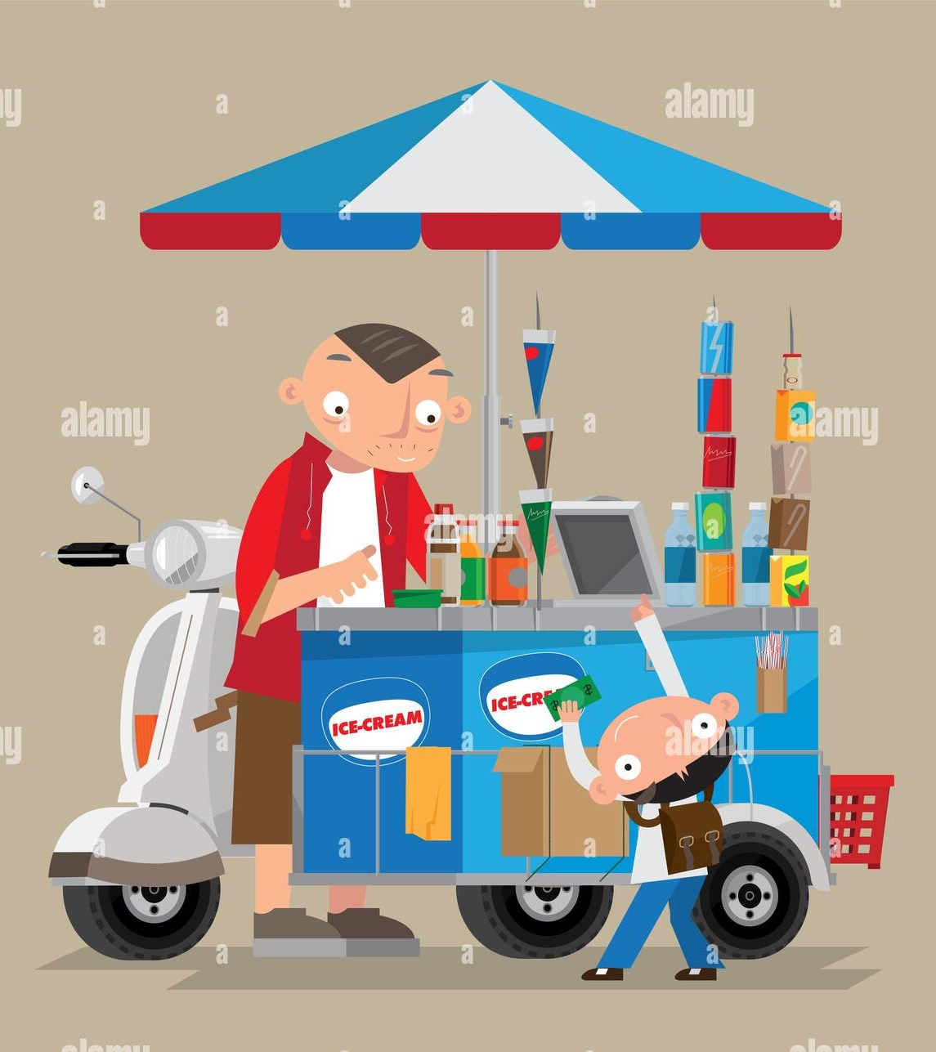
Who are hawkers?
A person/ Salesman who travels about selling goods, typically advertising them by shouting.

Slide 3

Problem statement
I had an issue with garbage collectors near my home.

Slide 4
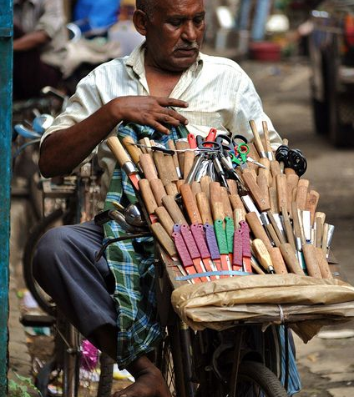
Then with a knife sharpener!

Slide 5
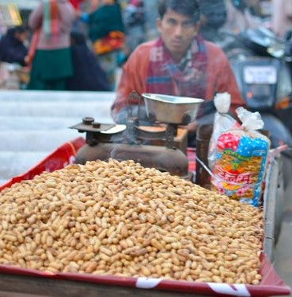
Then with a peanut vendor

Slide 6

This got me thinking
WHAT’S COMMON AMONG ALL THESE ISSUES??

Slide 7


ALL OF THEM ARE HAWKERS!

Slide 8
SOLUTION?

Slide 9

A PLATFORM FOR HAWKERS AND CUSTOMERS!

Slide 10
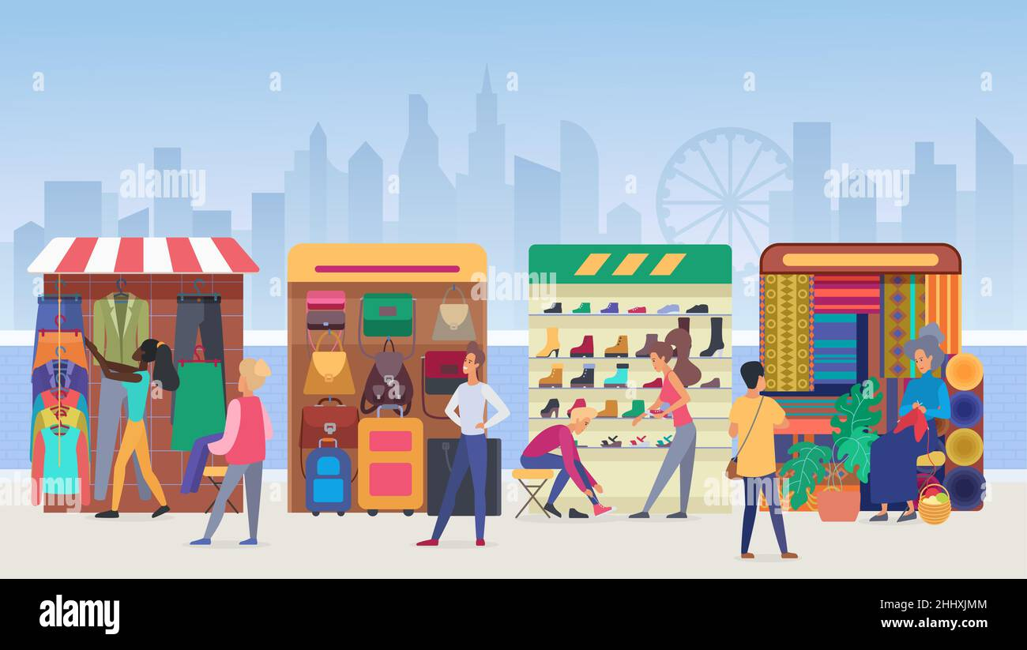
The Platform will contain two parts:
HAWKER/vendor
USER
Vendors would be able to share their live location, type of product/ service offered, menu, etc.
Users would be able to track the vendors near them, and also be able to send a service request.

Slide 11
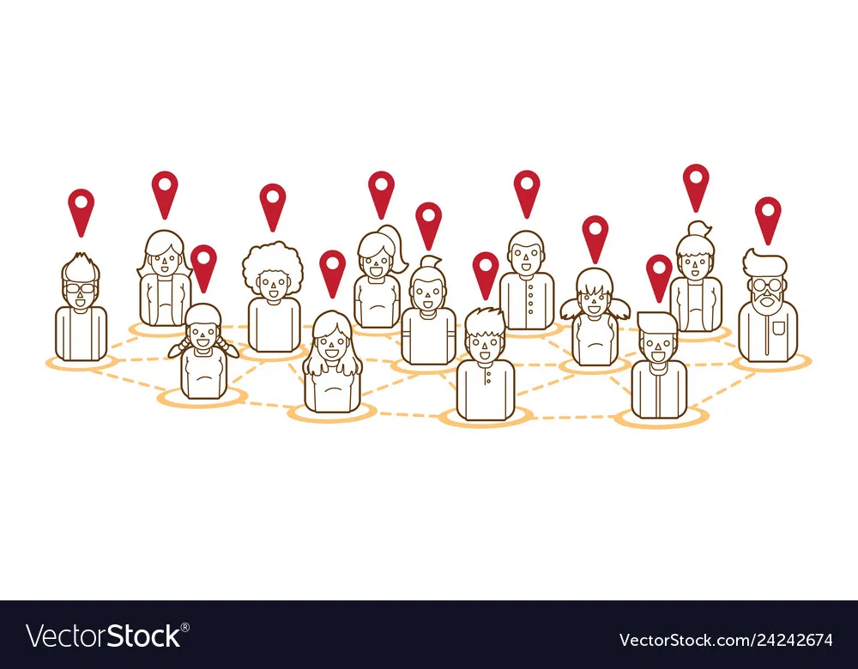

Features for vendors:
Will be able to share their live location, type of service offered, status, etc.
Vendors would receive service requests for customers, along with their location details.
Can maximize sales by evaluating customer service requests.

Slide 12
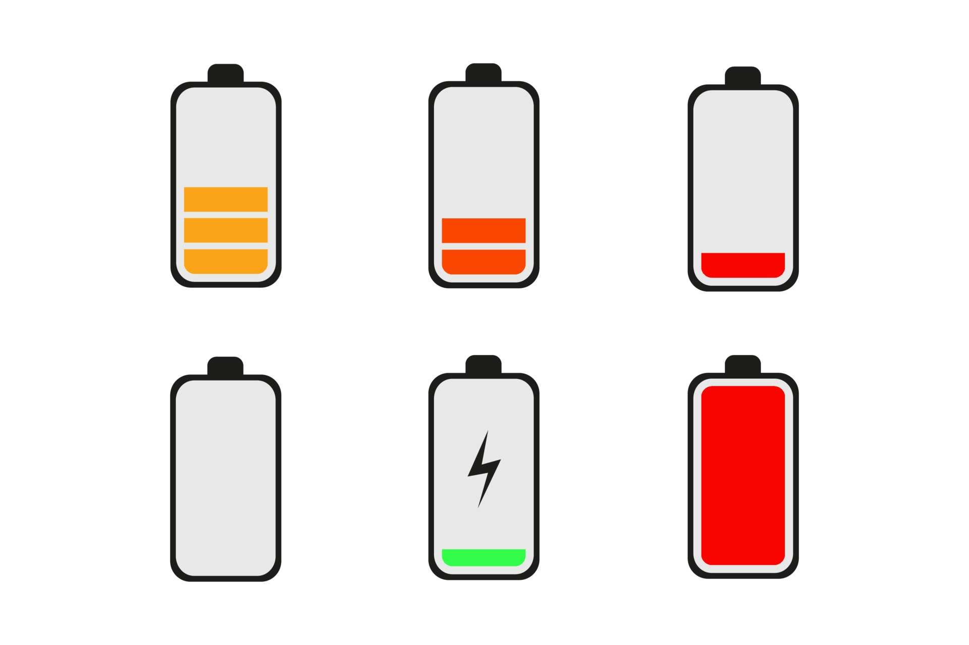
BUT HAVING THE LIVE LOCATION ON ALWAYS BE SUSTAINABLE?
The answer is Obviously NO!
Sharing Live Location consumes power at a much higher rate, which would drain the battery of the vendor’s device rapidly, which is not practical.

Slide 13

Solution!
The vendor would have the option to pause the live location while sharing the last stopped location.
For example, a vendor can go to his selling spot and pause the location sharing but select the option to display the location of his spot.

Slide 14
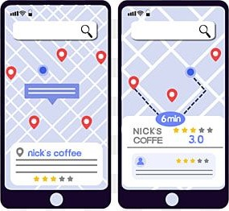
Features for customers:
Access to the location of the vendor, status, rating, etc.
Eg: Nick’s Coffee

Slide 15

Features for customers:
Will have access to the exact location of vendors, availability of their service, menu, description and customer reviews.
Customers will be able to send a customer service request to vendors along with their location details.

Slide 16
USABILITY AND BENEFITS:
what is the usability?
what are the benefits?

Slide 17

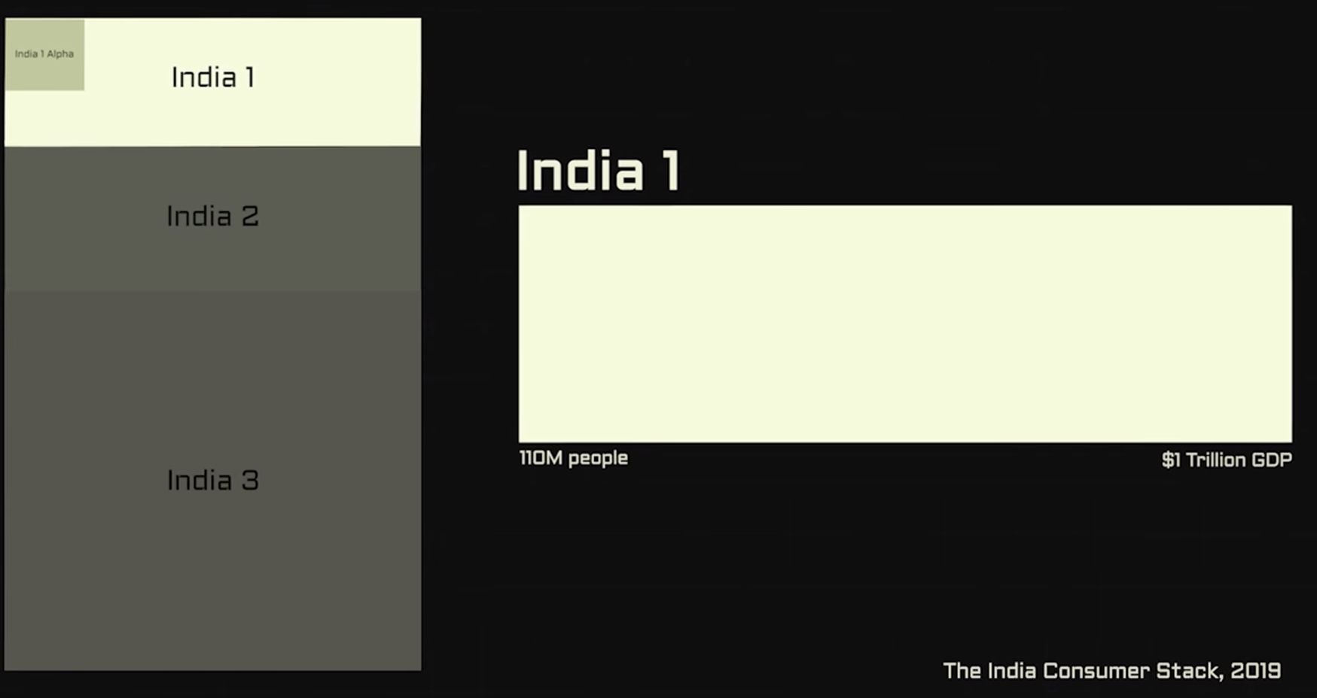
Target demographics:

Slide 18
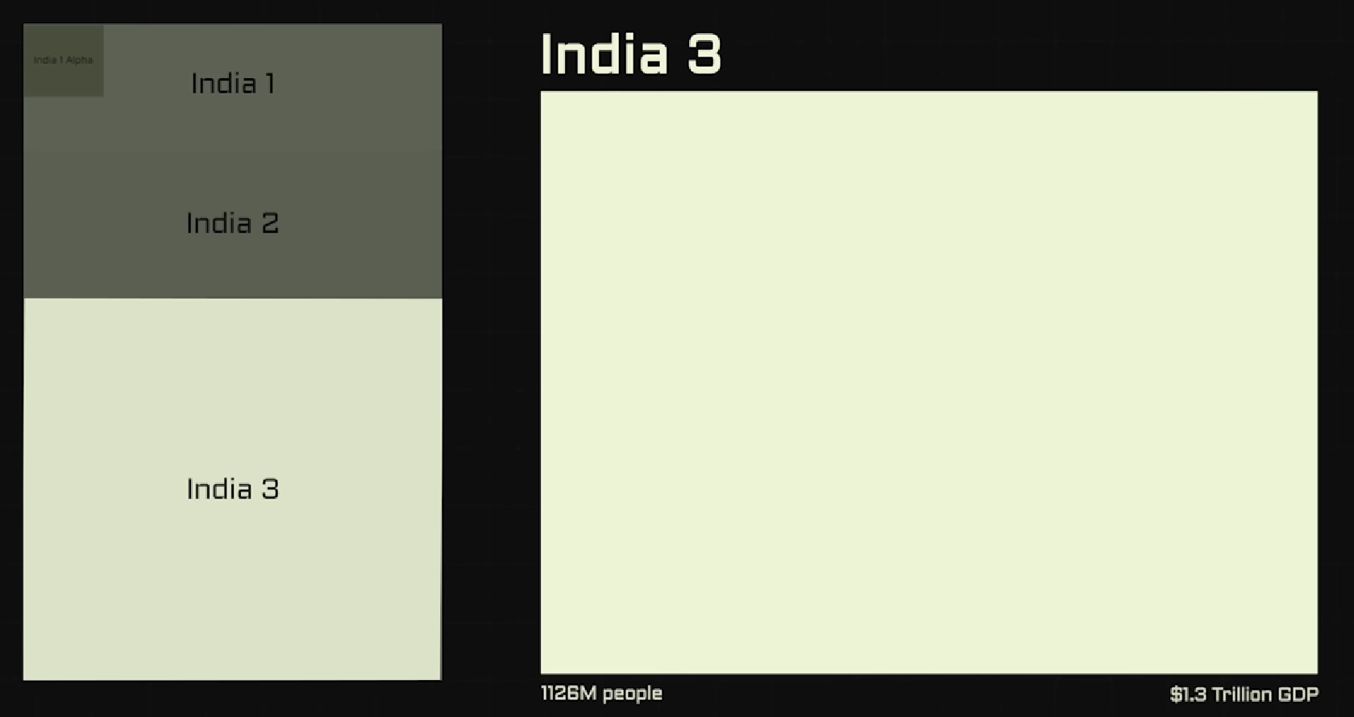
Target demographics:

Slide 19
Target demographics:
We Target Tier-3 India which has the largest population.
Empowering and supporting small-scale businesses and helping to develop the country.

Slide 20

System requirement
Front-End Technology: Flutter
Backend Technology: Laravel
Database: MySQL

Slide 21
Thank You!

